Slide 1
LearnMate®
Customer Training

Slide 2
What is LearnMate®?
LearnMate is intelitek’s custom learning management system
Library of Content for classrooms, schools, districts and states.
Automates time-consuming tasks like student enrollment and grading.
Connect with students through rich, interactive content with relevant application.

Slide 3
A Blended Learning Ecosystem
Friendly LMS
Interactive CONTENT
3D Simulations

Slide 4
LearnMate Content
intelitek modules provide virtual hands-on experience.
Rich in interactive animations, video, high-quality graphics and realistic simulations, including 3D modeling simulation software.
Highly interactive, unparalleled learning experience
Mapped to International Standards
All modules can be modified and expanded to meet the customer’s specific educational, vocational and language needs

Slide 5
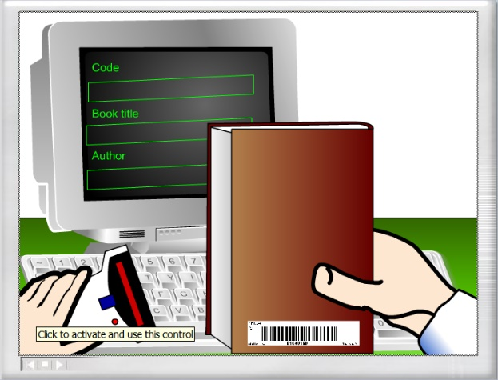
Virtual Hands-On Learning
Students experience the technologies…
… through hands-on practice in virtual settings

Slide 6
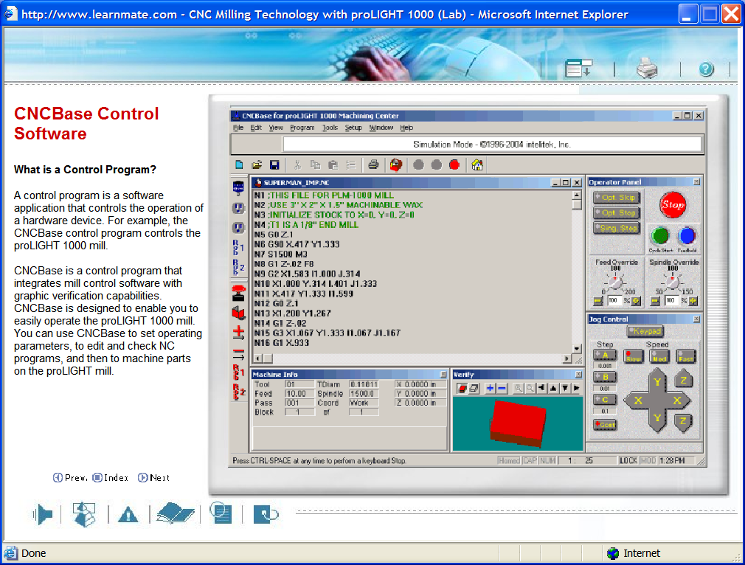
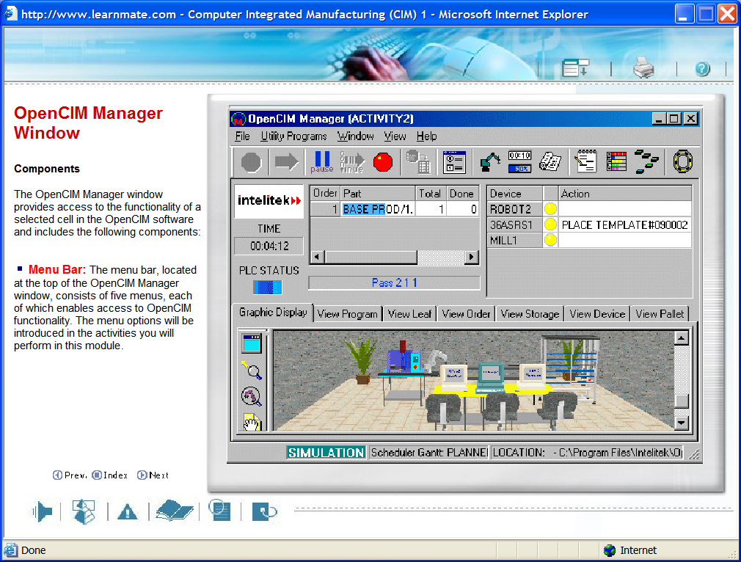
LearnMate Content
LearnMate lessons include…

Slide 7
Learning Management System (LMS)
Key Features
Leverages most popular educational platform – Moodle
Accessible anytime & anywhere
Collaborative Tools and Activities
Advanced reporting & analytics
Multi-lingual Support
Progress Monitoring
Flexibility to customize LMS theme

Slide 8
LearnMate Roles
Site Administrator:
Have the ability to do everything on the LearnMate site.
Intelitek admins are the only ones with this role.
Site Manager:
Has the ability to create courses, modify courses and perform admin tasks related to courses, users, grade settings, etc.
Teacher: A Teacher has the ability to manage and add content to courses.
Non-Editing Teacher: Can grade in courses, but cannot edit courses.
Students: Can access and participate in courses.
Guests: Can view courses, but cannot participate in them.

Slide 9
LearnMate Content
Key Features
Over 3,000 hours of curriculum
Flexible and easy to use Content
Embedded Simulations
Interactive Course Activities
Multi-lingual Content
Quizzes and Exams to test learning
Customization Options
Enhanced learning for the classroom

Slide 10
LearnMate 7 Content List

Slide 11
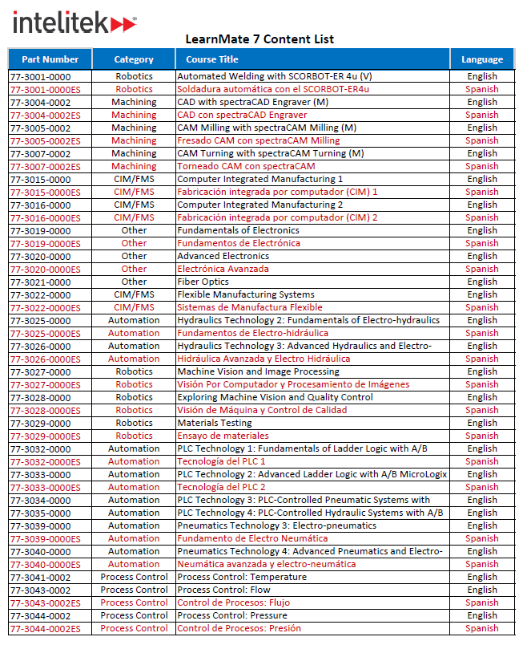
LearnMate 7 Content List
Over 3000 hours of SCORM-compliant curriculum
Multi-lingual Course Offering
Courses offered in both English and Spanish

Slide 12
LearnMate Content
Interactive Activities
Click on objects for interactive learning
Keeps students engaged
Learn additional features
Test student knowledge

Slide 13
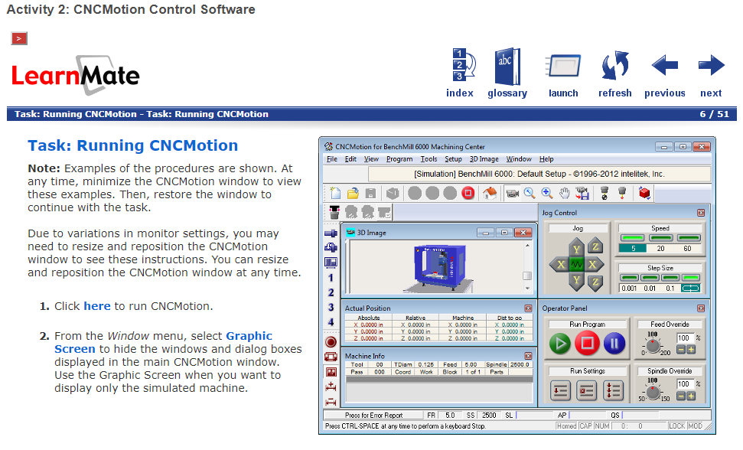
LearnMate Content
Software Simulation
Launch directly from content
Simulates supported hardware
Students learn all features and functionality
Practice programming through project-based learning

Slide 14
Cloud-Based Hosted Solution
Key Features
Software as a Service (SaaS)
99.9% up-time
Secure Content
Infrastructure and IT Support
Hassle free, automatic updates

Slide 15
LearnMate Hosting Options
When customer’s purchase content from Intelitek, they must also purchase LMS hosting
They have three options:
Dedicated Hosting: Dedicated LearnMate site for a school – BEST OPTION
https://school.intelitek.com
District Hosting: Dedicated LearnMate site for the entire school district
https://district.intelitek.com
Shared Hosting: Shared LearnMate site for all schools
https://onlinelearning.intelitek.com
Notes:
4. Local Installations: LearnMate installed on a school’s local server

Slide 16
LearnMate Dedicated Hosting Vs. Shared Hosting Vs. Local
 | Dedicated Hosting | Shared Hosting
Dedicated website | X
Full admin capabilities | X
Ability to backup/restore courses | X
Unlimited # of courses | X
Advanced Reporting option | X
Teacher Capabilities:
View Course Material | X | X
Modify Course Material | X
View Grades | X | X
Modify Grades | X
Enroll students (w/ email addresses) | X | X
Enroll Students (w/o email addresses) | X

Slide 17
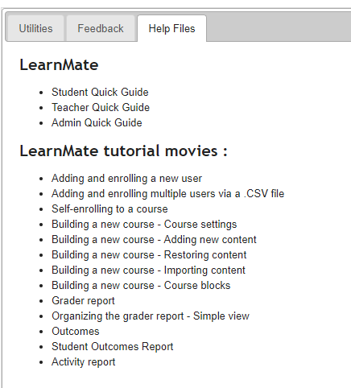
LearnMate Resources
Quick Guides
Student
Teacher
Administrator
LearnMate Tutorials
Short video clips teaching you how to do the most common tasks
Technical Support

Slide 18
LearnMate Resources
Quick Guides
Student
Teacher
Administrator
LearnMate Tutorials
Short video clips teaching you how to do the most common tasks
Technical Support

Slide 19
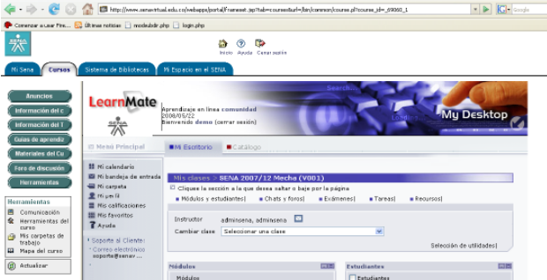
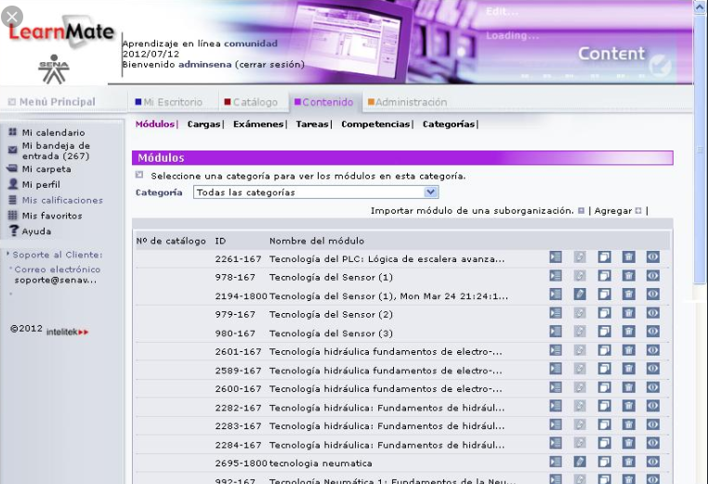
LearnMate Success Stories
SENA COLOMBIA
Since 2005 Intelitek is involved in national scale projects, supplying SENA with training solutions on a national level and to various SENA campuses. These solutions include E-Learning content in technological subjects, to hundreds of thousands of trainees, as well as furnishing Industrial Grade Training equipment in a variety of technological subjects in many of SENA’s campuses SENA (Servicio Nacional de Aprendizaje)-is a large Colombian training organization providing skills training for about 4 million students in Colombia for the age of 14 to 80, with multiple campuses, with a primary national goal of providing skills-based training at various levels.

Slide 20
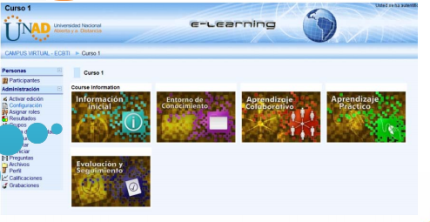
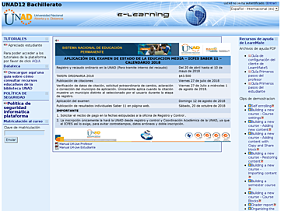
LearnMate Success Stories
UNAD COLOMBIA
Colombia’s Open University
In the last few years Intelitek provided UNAD with a verity of training solutions in the field of Science and Technology. These solutions include an full scale LMS with E-learning virtual modules that enable UNAD’s students throughout Colombia to launch E-Learning content and study various subjects at their own pace, in Technology (Automation, Hydraulics, Pneumatics, Robotics, Automatic Manufacturing etc.) and Science content in the field of Physics, Chemistry, and BiologyOther systems (hardware, simulation software, and interactive E-Learning content) provided are in the field of Engineering.

Slide 21
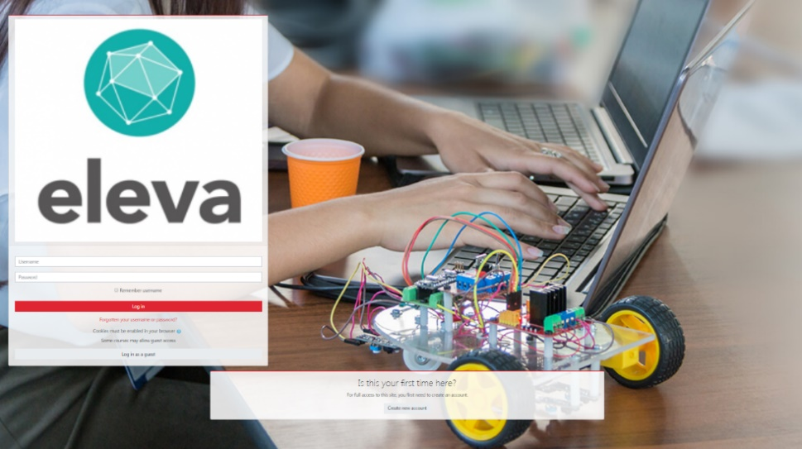
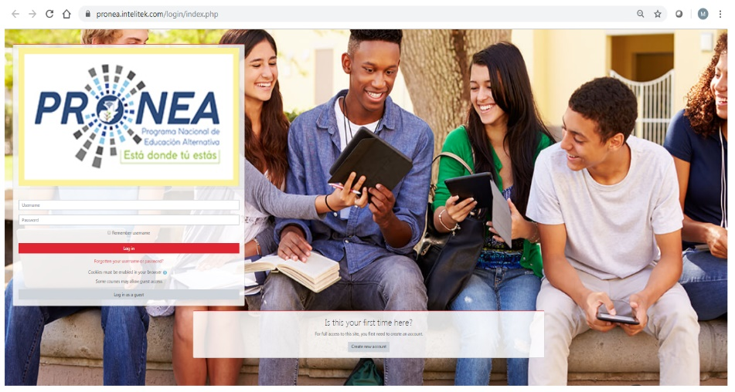
LearnMate Success Stories
CHILE – ELEVA
LearnMate 7 Hosted Server Management Station
LearnMate 7: https://eleva-santiago.intelitek.com/login/index.php
GUATEMALA - PRONEA
LearnMate 7 Hosted Server Management Station
LearnMate 7: https://pronea.intelitek.com/login/index.php

Slide 22
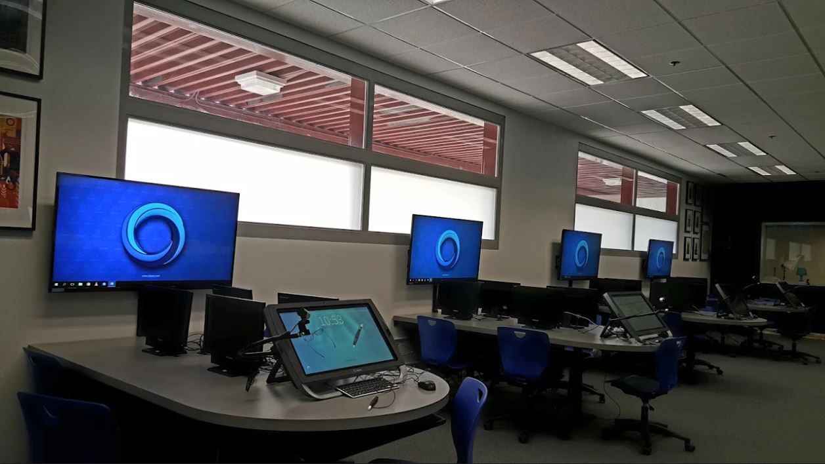
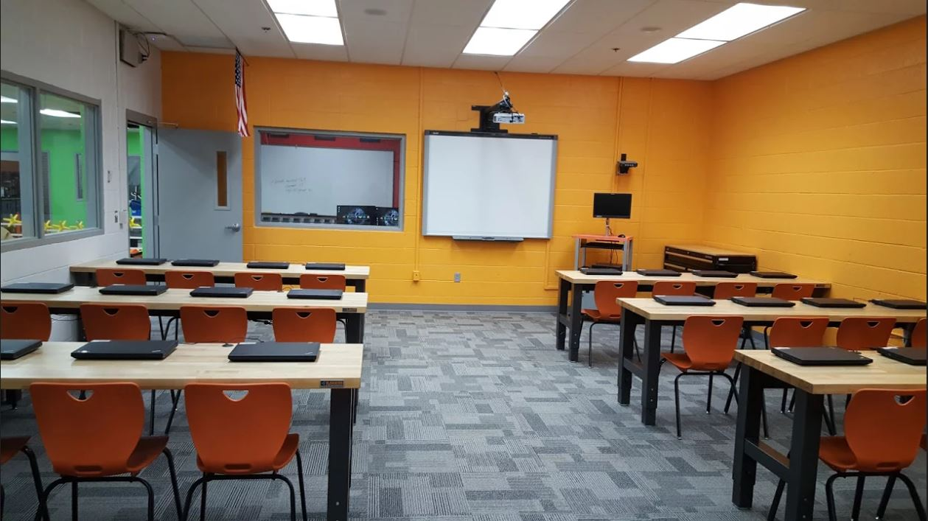
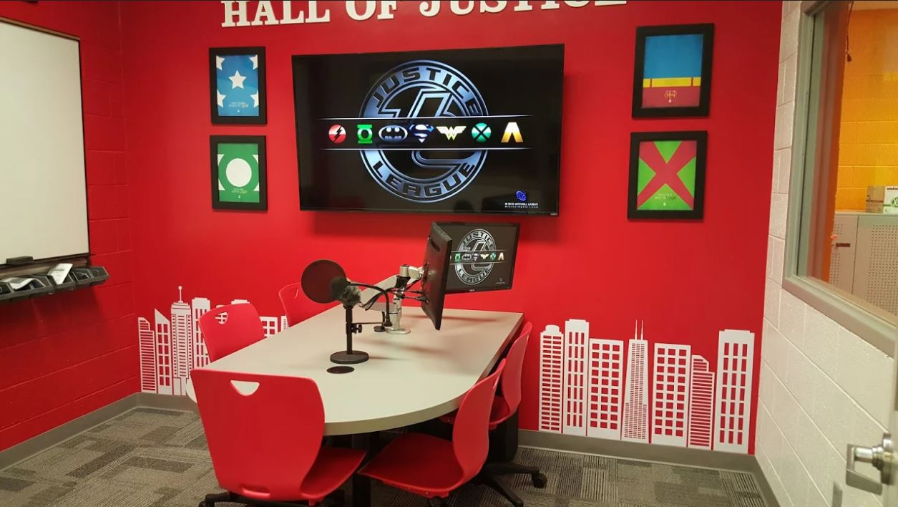
Case Study: Cimarron High School, Las Vegas, NV 4 Year High School Manufacturing Program

Slide 23
Case Study: Cimarron High School Manufacturing Sponsored by Tesla
Advanced Manufacturing Training answers an acute need for workers in the United States to fill 21st century jobs
Cimarron strives to train graduates who are qualified, tech literate and have manufacturing and production knowledge
As a strategic advisor and sponsor, Tesla enabled the program to be set up in a way that benefits industry

Slide 24
Questions?

Slide 25
Intelitek’s LearnMate E-Training Solutions
Learning Management System (LMS): a Web-based platform for complete management of the learning process.
LearnMate Content: A complete technology training program based on virtual “hands-on” simulation practice.

